Slide 1
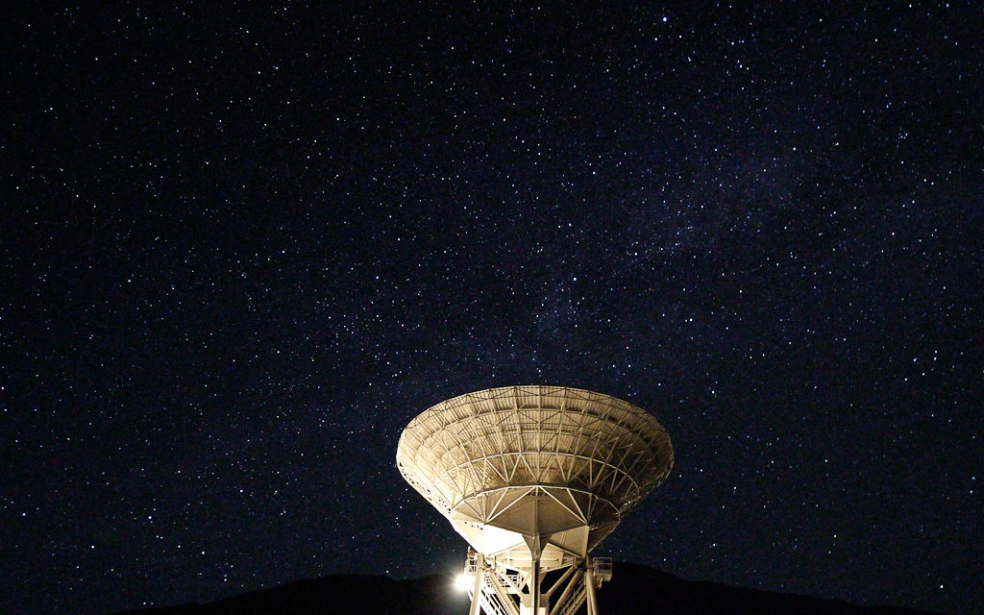
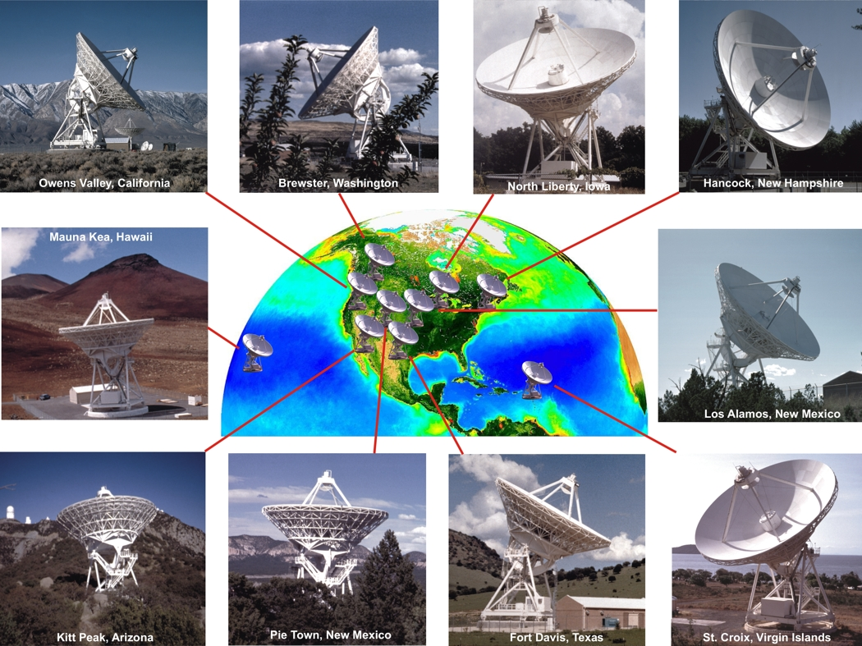
Machine Learning at the VLBA
Kiri Wagstaff, kiri.wagstaff@jpl.nasa.gov
Detect pulses
Don’t know when or at what frequency
Classify into types: pulsar, artifact, good candidate
Goal: Discover new radio sources
VLBA: 10 25-m telescopes, 8600-km baseline
Contributors: Walter Brisken, Sarah Burke-Spolaor, Adam Deller, Shakeh Khudikyan, Walid Majid, Divya Palaniswamy, Benyang Tang, David Thompson, Steven Tingay, Randall Wayth

Slide 2


(Fast Radio Bursts)
V-FASTR: VLBA Fast TRansient Experiment
Baseband data
Filterbank data
DiFX Correlator
V-FASTR Candidate Detection Pipeline
Candidates
Remove narrow-band RFI
Dedispersion
Detect correlated signals (adaptive sum)
Tags
V-FASTR Archive
Web portal: http://curta.pawsey.org.au/

Slide 3

V-FASTR Classifier Filtering
Machine
Classifier
Candidates
Baseband data
Filterbank data
Good candidates only
V-FASTR Candidate Detection Pipeline
Tags
DiFX Correlator
Remove narrow-band RFI
Dedispersion
Detect correlated signals (adaptive sum)
Tags
V-FASTR Archive
Web portal: http://curta.pawsey.org.au/

Slide 4
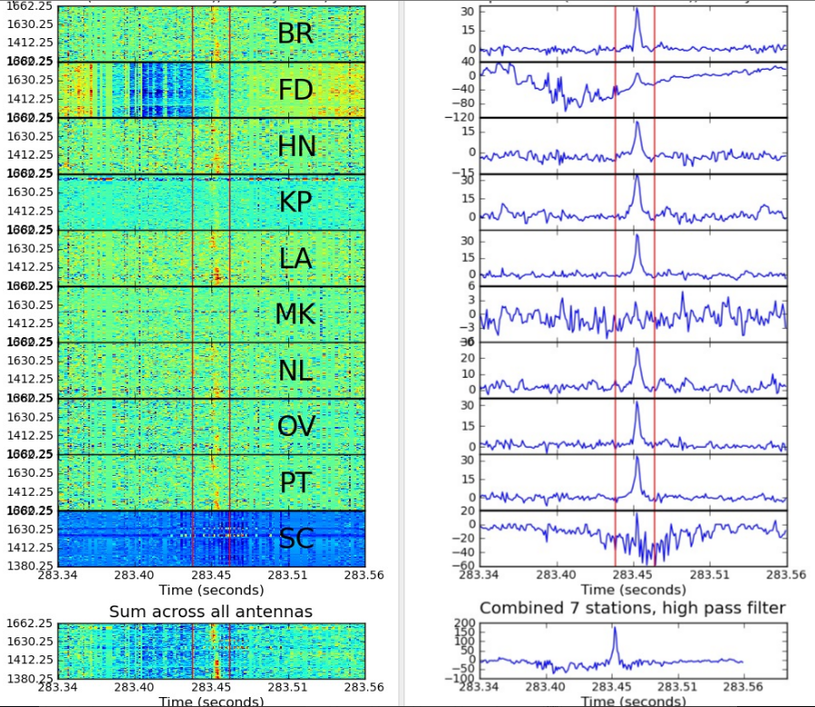
Filterbank per station
Dedispersed time series
Pulsar!
Notes:
http://curta.pawsey.org.au/portal/event/tns_inbeam3bd174bo_3%7Cs0%7Ce72

Slide 5
V-FASTR Abstaining Classifier
Candidate
Classify: Tag as “pulsar” or “artifact” if confidence > 0.9. Otherwise, do nothing.
Pulse
Artifact
?
Consult known pulsar DB
Known pulsar
Good candidate
Worthy of human review
No need for human review
Notes:
Random forest

Slide 6
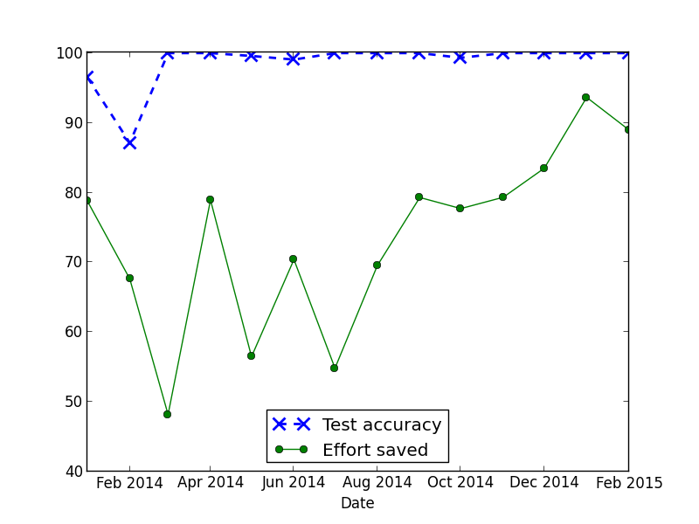
V-FASTR Classifier Performance
High accuracy and reliability
Remaining human effort
Percentage
Handled by classifier

Slide 7
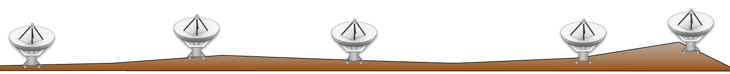
What has V-FASTR Found?
Human labels
Pulsar | Artifact
4,669 | 3,685
Machine predictions
Pulsar | Artifact | Good Candidate
19,842 | 51,311 | 18
Several known pulsars
Many, many artifacts
Aligned RFI (radio frequency interference)
Single-antenna detection
Antenna dropouts and other issues
Some good candidates
All associated with pulsars, but unusual properties
Ongoing campaign since July 2011
local RFI
Notes:
Analyze good candidates
- V-FASTR: detecting artifacts can help diagnose problems in pipeline

Slide 8
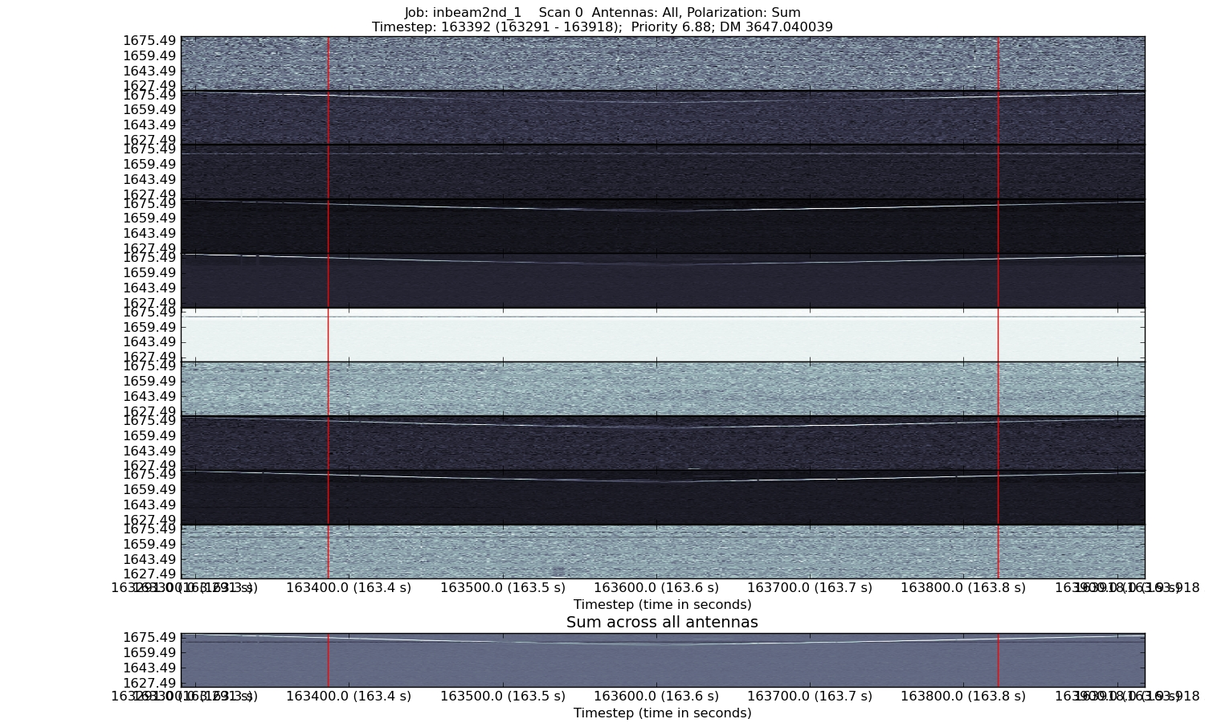
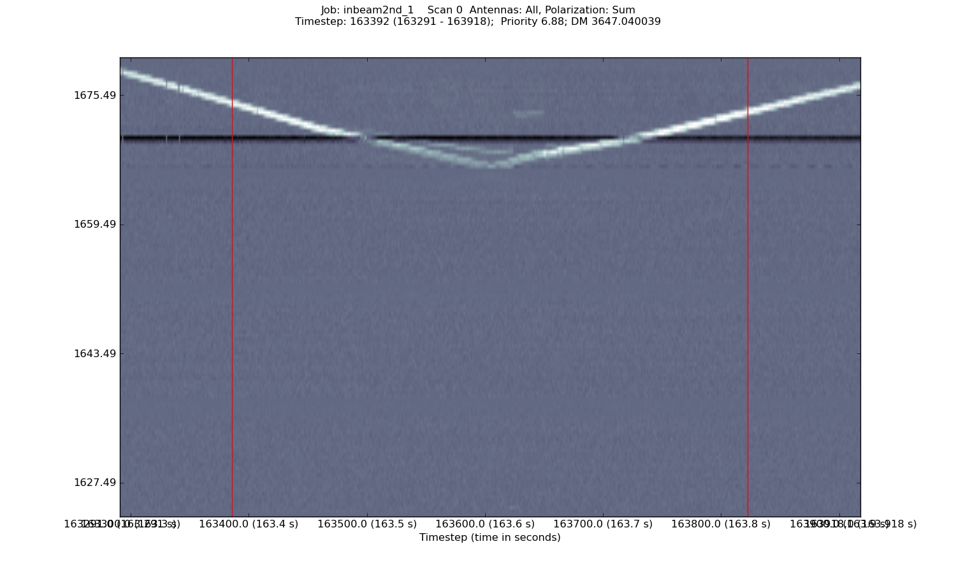
Mystery: “V-chirp”
Summed across stations:
5 examples in 4 months
Not VLBA artifact
Similar signals seen by GBT, 350 MHz
Not local RFI (multi-station)
Not lunar echo (some high declinations)
Not radiosonde (at least 1200 km alt.)
Satellite?

Slide 9
Key Lessons from V-FASTR
ML classifier greatly reduces human effort
Abstaining classifier ensures high reliability
Need for adaptation: Signals and noise (RFI) properties change over time
Integrated human review provides a stream of updated labels (feedback to classifier)

